Slide 1
Gladiator Case Study Presentation
Room Management System (RMS)
SOLUTIOKNIGHTS
Ragini (Team Leader)
Sourabh
Hrishikesh
Ankur
Sugandha
Gayatri
Gaurav
Notes:
Explain the problem statement.
(Club Management System)
Demo of the application.
Key Features and functionalities implemented in the Application.
Application structure – top level View.
Database Design
Showcase key “Queries”
UI Design Presentation (Snapshots).
Any design artifacts - Pseudo code
Overview of the Coding and Naming convention used in their projects.
Implementations showcasing reusability and extensibility
Implementations showcasing Object oriented essence and the benefits derived in the implemented project
Overall Experience of development.
Debugging Experience
Dos and Don’ts -- Code Development , DB design , Queries

Slide 2
Agenda
Background Study
Problem Statement
Proposed System
Business Benefits of the System
Technology & Technical Benefits of the System
Modules & functionalities of the application
Team Member Ownership
FRS
Database Design
Key Queries

Slide 3
Background Study
Learning and Development department is a part of L&T Infotech
Learning and Development department
      Align learning with business
      Integrate learning with HR & business process
      Create learning culture
Current System

Slide 4
Problem Statement
Security is inversely proportional to comfortability
Consistency of data
Human error
Expected skilled user
Time consuming and tedious
Notes:
Explain the purpose of the project/case study in 2/3 lines.
Describe the Core Need (Abstraction)

Slide 5
Proposed System
Automated System
Roles definition
User friendly
Effective and Faster
“YOU ARE BEST AT POLISHING YOUR EMPLOYEES ,
WE ARE THE BEST AT HELPING YOU DO JUST THAT”

Slide 6
Business Benefits of the System
Business Analysis using report generation will be done easily
Easily come to know the requirement for the new rooms and facilities
Proposed system will allow you to manage remote locations too
Effective use of resources can be done

Slide 7
Technology & Technical Benefits
JAVA ENTERPRISE EDITION : Platform independent, Write Once Run Anywhere
ENTERPRISE JAVA BEAN : Managing transaction, Easily managed security ,Supports stand alone application
MS SQL SERVER 2005 : Security,Stored Procedures,Scalability
Transaction Logs,Automatic Backup

Slide 8
Modules & functionalities of the application
1. User Management
Create User
Update User
Delete User
Block User
Unblock User
Activation User
2.Room Management
Create Room
Update Room
Delete Room

Slide 9
Modules & functionalities of the application
3. Booking Management
Single Day Booking
Multi Day Booking
Search Booking 4. Report Generation
BU wise report generation
Program wise report
5.Communication
Email notifications

Slide 10
Team Member Ownership
Name | Ownership | Description
Sugandha Hrishikesh Ragini | Documentation UML design DataBase design | Create and Maintain all document UML diagrams and Use cases Design Design the database
Sourabh Gaurav | Coding Testing | Code the logic for fulfilling the requirement Find out the bug and errors using test cases
Gayatri Ankur | User Interface Presentation | Design attractive user interface Present the project to customers or clients
Notes:
OWNERSHIP OF EACH MEMBER
FUNCTIONAL MODULES TO BE WORKED BY EACH MEMBER
FOOTNOTE:
WILL NOT HAVE ANY MEMBER JUST WORKING ON ONLY ONE ASPECT
10

Slide 11
Task Allocation
Task | Name
Documentation User Interface design | Sugandha , Ankur , Gayatri Gayatri , Sourabh , Sugandha
Coding Database | Sourabh , Hrishikesh , Ankur Ragini , Gaurav
Testing | Gaurav , Hrishikesh

Slide 12
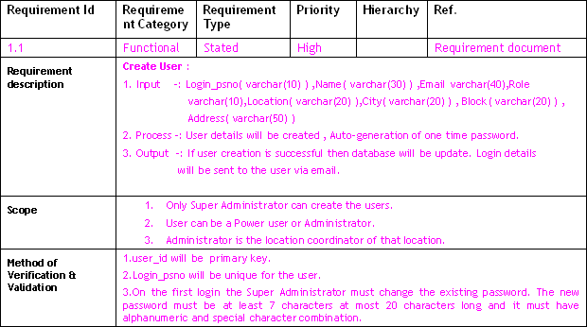
FRS – Functional Requirement Specification
Example : Create User

Slide 13
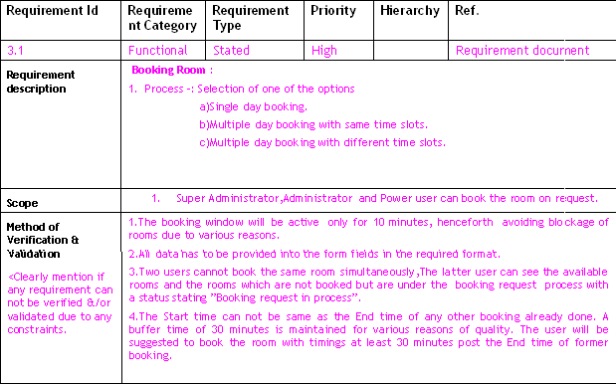
FRS – Functional Requirement Specification
Example : Booking Room

Slide 14
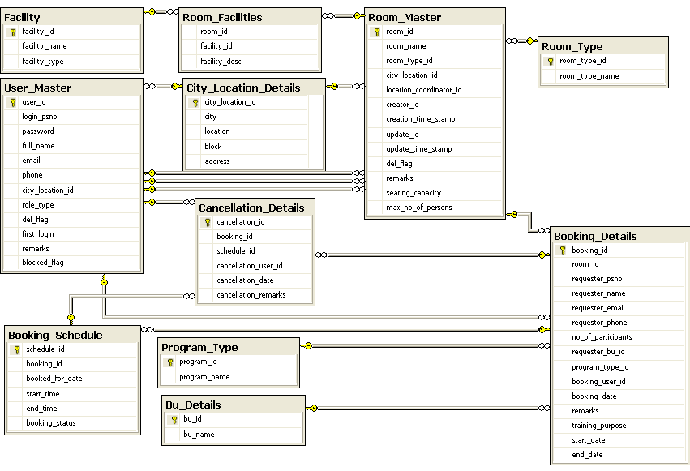
Database Diagram

Slide 15
Design Artifact-Class Diagram
CLASS DIAGRAM

Slide 16
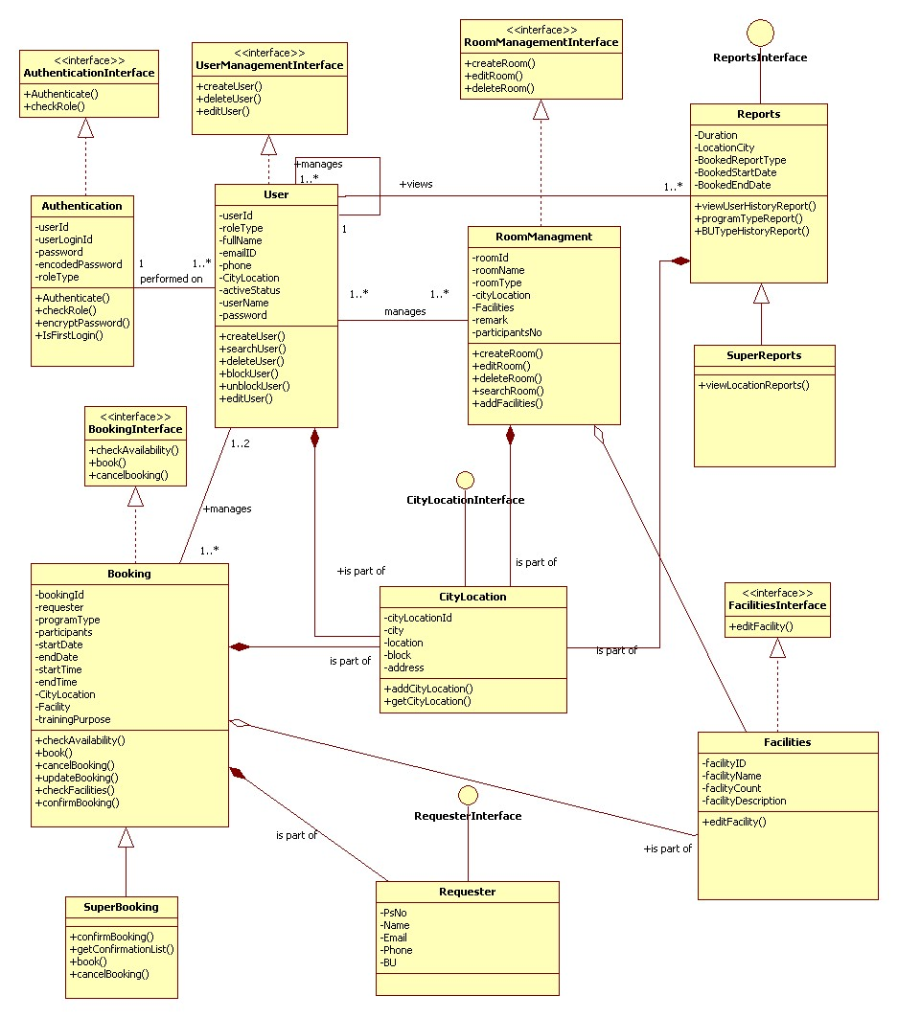

Slide 17
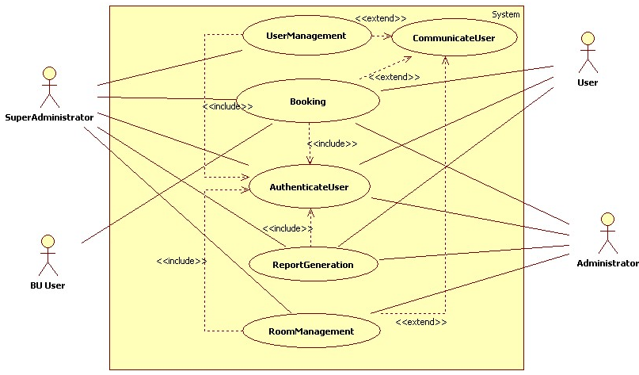
Design Artifact-Use Case Diagram

Slide 18
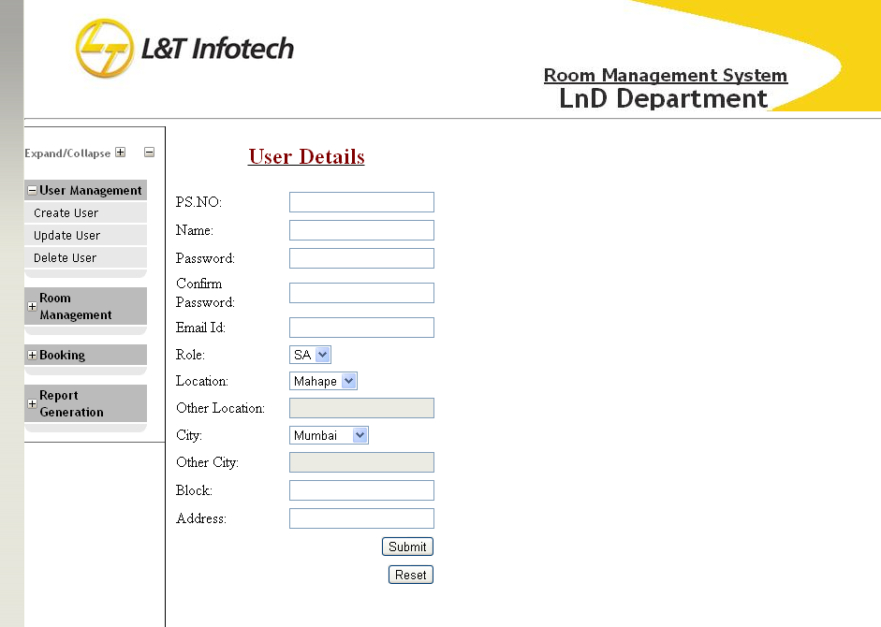
Proposed User Interface

Slide 19
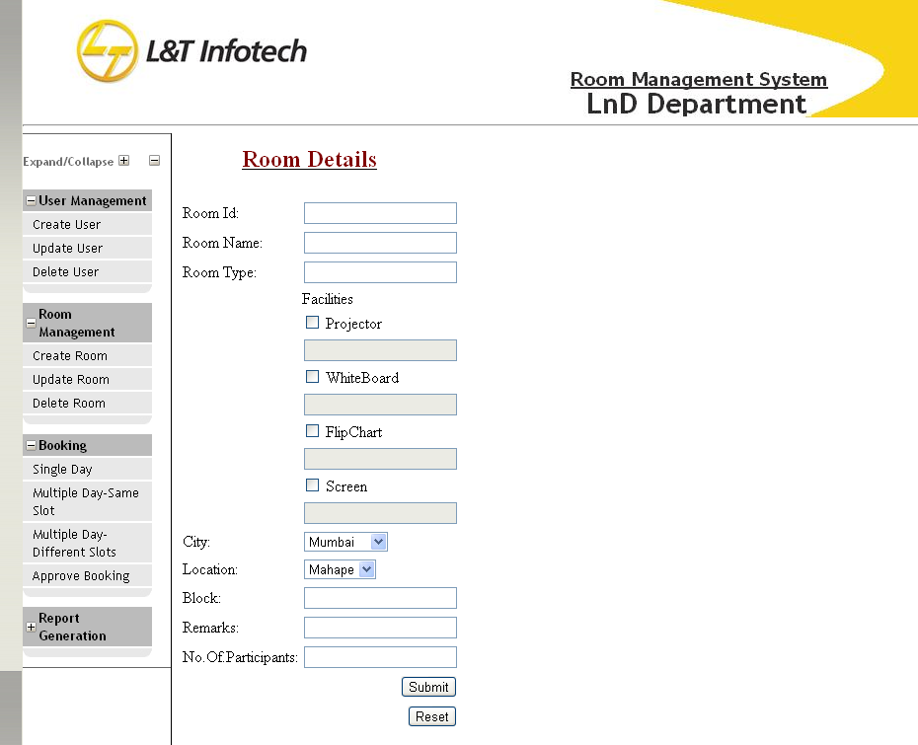
Proposed User Interface

Slide 20
Design Artifact-Sequence Diagram

Slide 21
Design Artifact-Activity Diagram

Slide 22
Application Structure – Top level View

Slide 23
Key “Queries”
Some Important Queries :
1. INSERT INTO BOOKING_DETAILS VALUES (2,'299421','RAGINI' ,'RAGS@GMAIL' ','548445',300,'dotnet',2,7,
'2012-03-06 10:00:00.000','')
2. INSERT INTO BOOKING_SCHEDULE VALUES (3,'2012-08-13','2012-08-13 09:00:00.000','2012-08-13 18:00:00.000',NULL,'CONFIRMED','DOT NET TRAINING')
3. UPDATE BOOKING_SCHEDULE SET
BOOKING_STATUS='CANCELLED',CANCELLATION_USER_ID=5,
REMARKS='HOLIDAY' WHERE BOOKED_DATE='2012-08-015'
AND BOOKING_ID=3

Slide 24
IMPORTANT QUERIES
4.SELECT ROOM_ID FROM ROOM_FACILITIES WHERE FACILITY_ID=2
AND FACILITY_DESC='1'
INTERSECT
SELECT ROOM_ID FROM ROOM_FACILITIES WHERE FACILITY_ID=4
AND FACILITY_DESC='1'
5. SELECT ROOM_NAME FROM ROOM_MASTER
WHERE ROOM_ID=11

Slide 25
THANK YOU

